Slide 1

Lecture
on
“Advanced Computer Architecture –TCS 704”
by
Akansha Gupta
DEPARTMENT OF COMPUTER SCIENCE AND ENGINEERING
GRAPHIC ERA DEEMED TO BE UNIVERSITY – 248002

Slide 2
PIPELINING PERFORMANCE-1

Slide 3
Performance of Pipelined Execution-
The following parameters serve as criterion to estimate the performance of pipelined execution-
Speed Up
Efficiency
Throughput

Slide 4
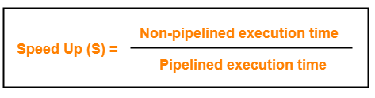
1. Speed Up
It gives an idea of “how much faster” the pipelined execution is as compared to non-pipelined execution.
It is calculated as-

Slide 5
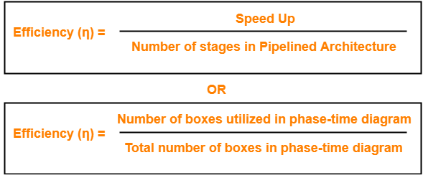
2. Efficiency
The efficiency of pipelined execution is calculated as-

Slide 6
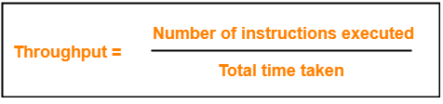
3. Throughput
Throughput is defined as number of instructions executed per unit time.
It is calculated as-

Slide 7
Calculation of Important Parameters
Let us learn how to calculate certain important parameters of pipelined architecture.
Consider-
A pipelined architecture consisting of k-stage pipeline
Total number of instructions to be executed = n

Slide 8
Point-01: Calculating Cycle Time
In pipelined architecture,
There is a global clock that synchronizes the working of all the stages.
Frequency of the clock is set such that all the stages are synchronized.
At the beginning of each clock cycle, each stage reads the data from its register and process it.
Cycle time is the value of one clock cycle.

Slide 9
There are two cases possible-
Case-01: All the stages offer same delay
If all the stages offer same delay, then-
Cycle time = Delay offered by one stage including the delay due to its register
Case-02: All the stages do not offer same delay
If all the stages do not offer same delay, then-
Cycle time = Maximum delay offered by any stage including the delay due to its register

Slide 10
Point-02: Calculating Frequency Of Clock
Frequency of the clock (f) = 1 / Cycle time

Slide 11
Point-03: Calculating Non-Pipelined Execution Time
In non-pipelined architecture,
The instructions execute one after the other.
The execution of a new instruction begins only after the previous instruction has executed completely.
So, number of clock cycles taken by each instruction = k clock cycles
Thus,
Non-pipelined execution time
= Total number of instructions x Time taken to execute one instruction
= n x k clock cycles

Slide 12
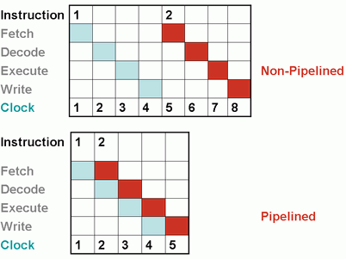

Slide 13
Point-04: Calculating Pipelined Execution Time
In pipelined architecture,
Multiple instructions execute parallely.
Number of clock cycles taken by the first instruction = k clock cycles
After first instruction has completely executed, one instruction comes out per clock cycle.
So, number of clock cycles taken by each remaining instruction = 1 clock cycle
Thus,
Pipelined execution time
= Time taken to execute first instruction + Time taken to execute remaining instructions
= 1 x k clock cycles + (n-1) x 1 clock cycle
= (k + n – 1) clock cycles

Slide 14
Point-04: Calculating Speed Up
Speed up
= Non-pipelined execution time / Pipelined execution time
= n x k clock cycles / (k + n – 1) clock cycles
= n x k / (k + n – 1)
= n x k / n + (k – 1)
= k / { 1 + (k – 1)/n }
For very large number of instructions, n→∞. Thus, speed up = k.
Practically, total number of instructions never tend to infinity.
Therefore, speed up is always less than number of stages in pipeline.

Slide 15
https://youtu.be/vQnjlra0Ea4
THANKS

